Slide 1
WelCome!

Slide 2
flowchart elemans
Flowchart and Sequence Diagrams

Slide 3
Flowchart and Sequence Diagrams: Introduction
This chapter covers the key elements of flowcharts and sequence diagrams, foundational tools for visualizing the logic and sequence of operations in systems and programs.
Notes:
Welcome the audience and introduce the importance of visual representations like flowcharts and sequence diagrams in systems analysis and design.

Slide 4
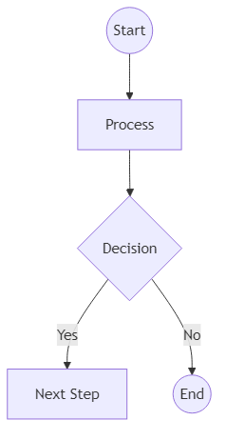
Flowchart Elements: Overview
A flowchart is a type of diagram that represents an algorithm, workflow, or process. It uses standardized symbols to denote different types of actions or steps in a process.
Notes:
Explain what a flowchart is and its purpose. Emphasize clarity and simplicity in process visualization.

Slide 5
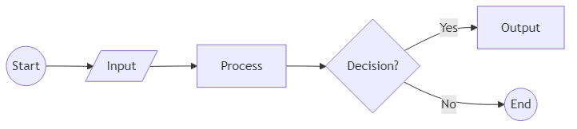
Common Flowchart Symbols
Flowcharts rely on a set of standard symbols to represent different actions or steps. The most commonly used symbols are:
- Oval: Start or End
- Rectangle: Process
- Diamond: Decision
- Parallelogram: Input/Output
- Arrow: Flow Direction
Notes:
Discuss each symbol in detail, giving simple real-world analogies if possible.

Slide 6
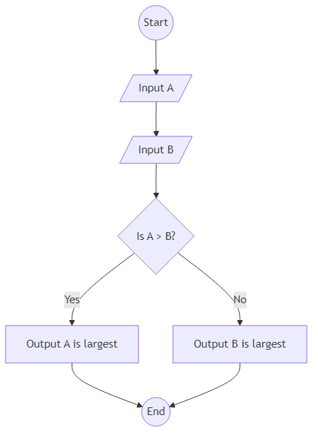
Example: Flowchart for Finding the Largest of Two Numbers
Let's look at a simple flowchart example that finds the largest of two numbers (A and B). The flowchart uses input, decision, and output symbols to illustrate the process.
Notes:
Guide the audience through the flowchart, explaining each step and symbol used.

Slide 7
Flowchart Pseudocode Example
Here is how the logic for finding the largest of two numbers can be expressed in pseudocode, corresponding to the previous flowchart.
Code Examples:
// Pseudocode for finding the largest of two numbers
Input A
Input B
If A > B then
Print 'A is largest'
Else
Print 'B is largest'
End If
Notes:
Show how the flowchart translates into pseudocode, helping bridge visual and textual algorithm representations.

Slide 8
Best Practices in Designing Flowcharts
To create effective flowcharts, follow these best practices:
- Use standard symbols consistently.
- Keep the flow from top to bottom or left to right.
- Avoid crossing lines and make the diagram as simple as possible.
- Label decisions and connectors clearly.
Notes:
Emphasize the importance of clarity and neatness in flowchart design. Give examples of both good and poor practices if time allows.

Slide 9
Summary: Flowchart Elements
Flowcharts are powerful tools for visualizing logic and processes. Understanding and using the correct symbols ensures your diagrams are clear and effective.
Notes:
Recap the key points of the chapter and encourage the audience to practice making flowcharts for various scenarios.

